Slide 1
Managing an Online Bookstore
Team Name : Task Titans
Team Members:
J. Varun Kumar
A. Charan Kumar
A. Vinay Kumar
K. Dheeraj Kumar
K. Manikanta Vinayak
Name of the mentor : Neetesh Parasar
7 August 2024

Slide 2
The problem statement
About your project-Why this project?
An online bookstore project is important because it offers a convenient way for people to discover and purchase books. It can support authors, publishers, and readers while also contributing to the literary community.
Why is this project important?
An online bookstore is important because it brings books to people anytime, anywhere. Customers can easily find and buy books without leaving home. It also helps authors reach a wider audience and can support local bookstores by offering their titles. Plus, online stores can offer a vast selection of books, making it a one-stop shop for book lovers.
Is the problem difficult to solve?
No, it's not difficult to solve. Building an online bookstore involves well-understood technology. The main challenges lie in attracting customers, managing inventory effectively, and providing excellent customer service.
How have you solved the problem?
To address the challenges, the project involved creating a user-friendly platform with intuitive navigation and robust search functionality. We implemented efficient inventory management systems to keep stock levels accurate and integrated secure payment options to protect customer transactions. The focus on excellent customer service and a comprehensive selection of books ensures a satisfying user experience and supports the growth and sustainability of the online bookstore.
About the project
Notes:
Notes:
In this session we look back at MPI Modules 4-6 and explore the concepts in more detail through the lens of some of the readings
Let’s get started

Slide 3
Objectives of the project
List all the objectives
Create a user-friendly online platform to sell books.
Offer a wide range of books with detailed information.
Provide a secure and efficient checkout process.
Ensure timely order fulfillment and delivery.
Build a loyal customer base through excellent service.
Generate revenue and profit through book sales.
Any sustainable benefits expected by a market or a population can be defined/listed
Lower transportation and operational emissions compared to physical bookstores.
Greater access to books for people in remote or underserved areas.
Objectives

Slide 4
Deliverables
E-commerce Website
Shopping Cart & Checkout
Order Management System
Inventory Management System
Project Documentation
Source Code
Deliverables

Slide 5
Background
Background about the basic aspects of the project
This project aims to create an online platform for selling books. Key components include product catalog, user management, order processing, inventory control, and payment integration. The goal is to provide a convenient and efficient book buying experience for customers.
Discuss the past or related work
Numerous online bookstores exist, such as Amazon, Barnes & Noble, 99bookstore,etc. These platforms offer varying models for book sales, customer experience, and inventory management. Our project aims to differentiate by focusing on books
Compare your work with other work
You may compare in terms of functionality, in terms of performance, and/or in terms of approach.
This project aims to create an efficient online book-selling platform with components like product catalog, user management, and payment integration.
Background
Notes:
Notes:
In this tutorial we will work through each of the three resources allocated as 30min exercises.
Working in groups with the provided guiding questions you will collate your thoughts and reflections from reading the paper and organize these thoughts in the light of the module’s perspective.
So, for the first module you will take the orientation that the module discusses and contemplate the learnings and meanings identified within the reading from this orientation
Once every group has had a chance to discuss and capture their thoughts, we will share these in short presentations to examine the depth and diversity of views from within the group.

Slide 6
Project Research and Initiation
List all the stakeholders:
Project Sponsor
Project Manager
Development Team
End Users
Librarians and Administrators
IT Department
Vendors/Suppliers
Regulatory Bodies
Executives and Management
Community or Public
Investors or Shareholders
Project Research and Initiation
Notes:
Notes:
Take each of the questions shown on the slide and answer them individually.
Discuss with your peers your thoughts. Are there consensus positions within the group?
If there are multiple viewpoints or different aspects of the work that are interesting, challenging, or “aha moments” for people please consider why the importance of these attributes may be different for different people

Slide 7
Project Research and Initiation
Explain what data was collected, how it was collected, the evaluation methods used, and how the data was analyzed to derive the quantifiable indicator
If you have used a questionnaire, write about it.
Customer satisfaction data was gathered using surveys and website analytics. Surveys included rating scales and open-ended questions, while analytics tracked clicks and purchases.
How did you make choices on the technologies to be used for the project?
Technology choices based on project requirements (scalability, performance), team expertise, cost, and community support. Evaluated options against these criteria to select best fit for project goals.
Work breakdown structure and task allocation among team members
WBS breaks down project into manageable tasks. Assign tasks to team members based on skills and workload. Visualize tasks and dependencies using tools like Gantt charts. Effective allocation ensures efficient project completion.
Project Research and Initiation
Notes:
Notes:
Take each of the questions shown on the slide and answer them individually.
Discuss with your peers your thoughts. Are there consensus positions within the group?
If there are multiple viewpoints or different aspects of the work that are interesting, challenging, or “aha moments” for people please consider why the importance of these attributes may be different for different people

Slide 8
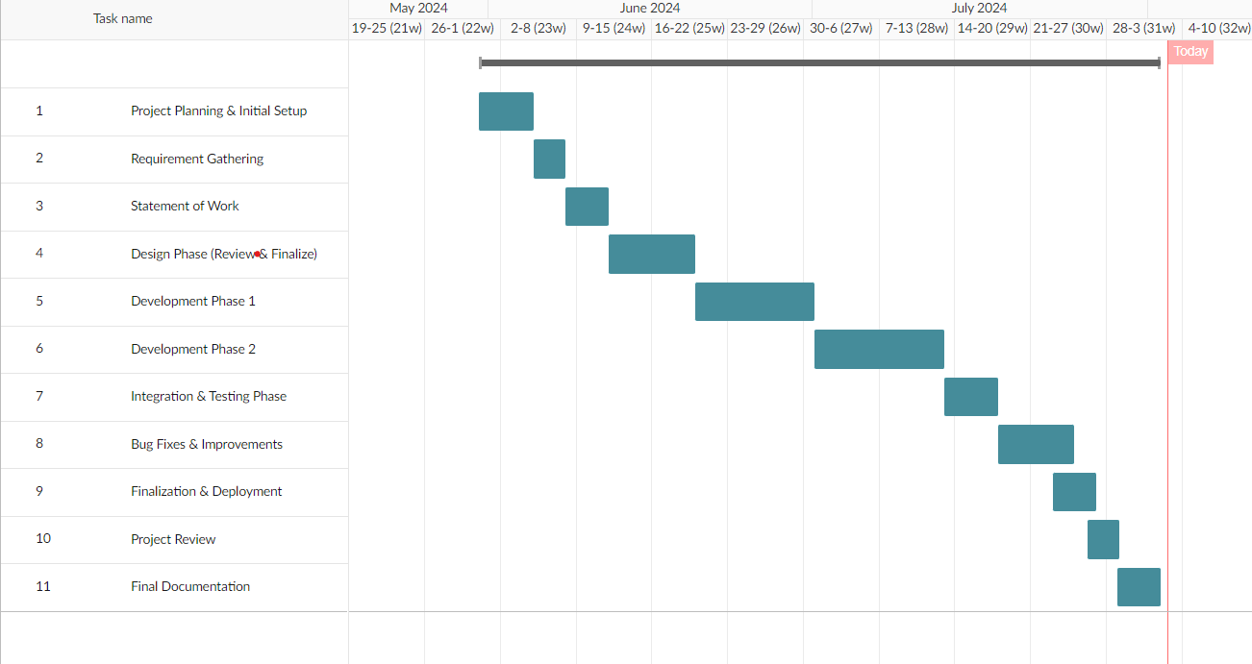
Project Research and Initiation-Planning and scheduling-Gantt Chart and Milestones
Project Research and Initiation
Notes:
Notes:
Take each of the questions shown on the slide and answer them individually.
Discuss with your peers your thoughts. Are there consensus positions within the group?
If there are multiple viewpoints or different aspects of the work that are interesting, challenging, or “aha moments” for people please consider why the importance of these attributes may be different for different people

Slide 9
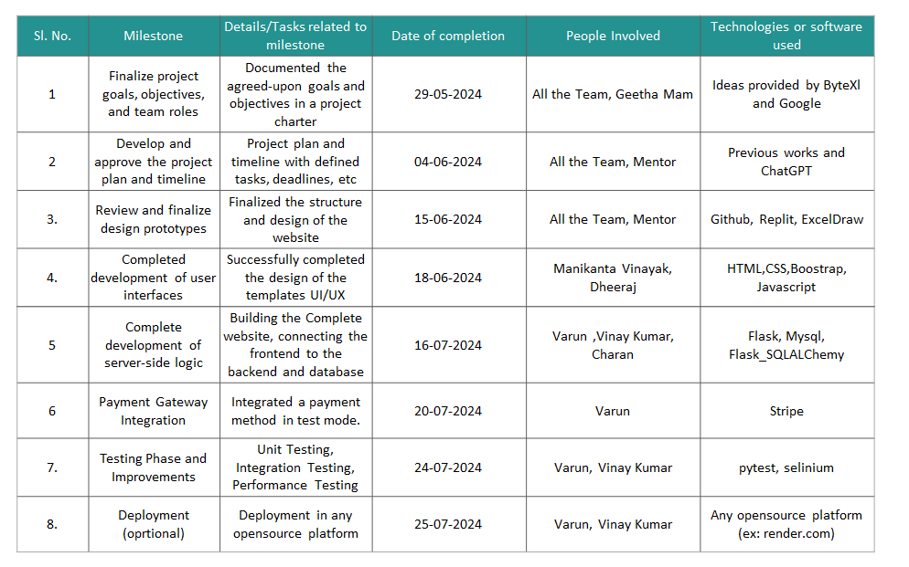
Project Research and Initiation
Notes:
Notes:
Take each of the questions shown on the slide and answer them individually.
Discuss with your peers your thoughts. Are there consensus positions within the group?
If there are multiple viewpoints or different aspects of the work that are interesting, challenging, or “aha moments” for people please consider why the importance of these attributes may be different for different people

Slide 10
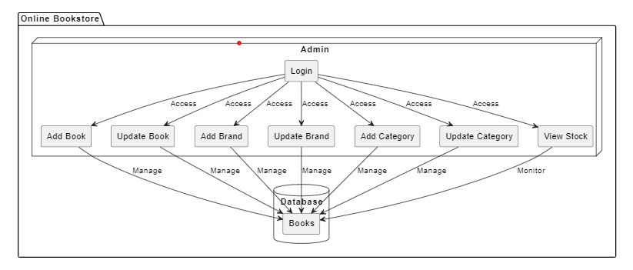
Project Development Cycle-System Diagram
Admin
Project Development Cycle

Slide 11
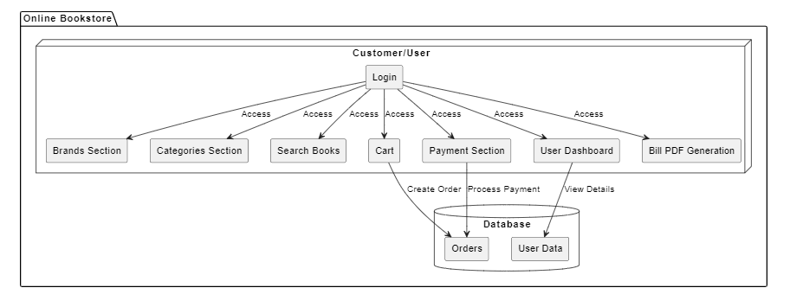
Project Development Cycle-System Diagram
Customer
Project Development Cycle

Slide 12
Project Development Cycle-Technologies used
Python with Flask (Backend):
Pros: Flask is lightweight and flexible, making it easy to set up and scale. It’s great for building RESTful APIs that your frontend can interact with
Cons: It may require more configuration compared to more heavyweight frameworks like Django, but it offers greater flexibility
Frontend (HTML, CSS, Bootstrap, JavaScript):
Pros: Easy to use with flexible design and rapid development using pre-built components.
Cons: Limited functionality with HTML alone, and CSS/JavaScript can become complex and impact performance.
MySQL (Database):
Pros: MySQL is a well-established, reliable, and widely-used relational database. It’s good for handling structured data and supports complex queries
Cons: You’ll need to manage schema changes and ensure that your queries are optimized for performance
Project Development Cycle

Slide 13
Project Development Cycle-Project execution
1. Database (SQLite3)
Setup: Designed the database schema to store book-related data, including tables for books, users, orders, and inventory, and defined the relationships between these tables.
Implementation: Used SQLite3 to create and manage the database, and wrote SQL scripts to create tables and insert initial data.
2. Backend (Flask with SQLAlchemy)
Setup: Installed Flask and SQLAlchemy, set up the project environment, and configured Flask for backend functionality.
Functionality: Added functionality using routes.py, managed data with models.py and forms.py, and handled initialization with __init__.py.
3. Frontend (HTML, CSS, Bootstrap, JavaScript)
Setup: Developed the frontend using HTML, CSS, Bootstrap, and JavaScript to build a user-friendly interface.
UI Design: Designed and styled components to display book data, including product listings and user forms.
Project Development Cycle

Slide 14
Project Development Cycle-Project execution
4. Integration
Routes and Data Handling: Implemented functionality through routes.py to handle user interactions and data processing.
Data Management: Used models.py and forms.py for managing data with the database.
Initialization: Configured the project setup with __init__.py.
Execution Flow
Database Initialization: Created and set up the SQLite3 database.
Backend Development: Developed functionality and data handling with Flask using routes.py, models.py, forms.py, and __init__.py.
Frontend Development: Built the frontend using HTML, CSS, Bootstrap, and JavaScript to present data and interact with the backend.
Integration: Connected the frontend to the backend and tested the overall functionality to ensure smooth operation between the database, backend, and frontend.
Project Development Cycle

Slide 15
Project Development Cycle-
Risks, challenges and mitigation
Website Development Delays: Development took longer due to extra design changes. We extended the timeline and shifted resources to stay on track.
Integration of Inventory Management System: Connecting the inventory system was trickier than expected. We brought in extra help to fix the issues and complete the setup.
Testing and Debugging: We found more bugs than anticipated, which needed extra time to fix. We allowed more time for testing and repeated it several times..
Project Development Cycle

Slide 16
Project Development Cycle-
Risks, challenges and mitigation
Security Concerns: There’s a risk of data breaches and fraud. We used strong encryption, secure payment methods, and regularly updated our security.
Legal and Compliance: We needed to follow laws and regulations. We kept up with legal changes and regularly checked our compliance.
Supplier Reliability: Unreliable suppliers could cause stock issues. We chose reliable suppliers and had backup options in place.
Scalability Issues: Handling more users as we grow could be a problem. We planned for growth and used cloud services to manage increased demand..
Book Piracy: Digital book piracy is a risk. We used DRM technology to protect books and took action against illegal distribution.
Project Development Cycle

Slide 17
Project Development Cycle-Change management
Addition of Brands:
Change: Added brands to the product list, even though we originally planned only categories.
Impact: Took extra time to set up and show brands. Made it easier for users to find products and improved navigation.
Inclusion of Payment Page and Bill:
Change: Added a payment page with Stripe and a feature to generate bills in PDF.
Impact: Required more time and effort to set up Stripe and create the billing system. Enhanced the checkout process and provided users with invoices.
Project Development Cycle

Slide 18
Project Development Cycle-Testing
1. Login Test
Goal: Check if a user can log in successfully.
Steps:
Open the login page of the website.
Enter a valid username.
Enter a valid password.
Click the login button.
Expected Result: You should see a welcome message or be directed to the user’s home page.
2. Product Search Test
Goal: Verify that the search function works correctly.
Steps:
Open the homepage of the website.
Type a book title into the search box.
Click the search button.
Expected Result: The search results should display the book or relevant products.
Project Development Cycle

Slide 19
Project Development Cycle-Testing
3. Add to Cart Test
Goal: Ensure that a product can be added to the shopping cart.
Steps:
Go to a product page.
Click the "Add to Cart" button.
Navigate to the cart page.
Expected Result: The product should appear in the cart with the correct details.
4. Checkout Test
Goal: Confirm that the checkout process works smoothly.
Steps:
Go to the cart page.
Click the "Checkout" button.
Enter payment details (like credit card number, expiry date, CVV).
Submit the payment.
Expected Result: You should see an order confirmation message or page.
Project Development Cycle

Slide 20
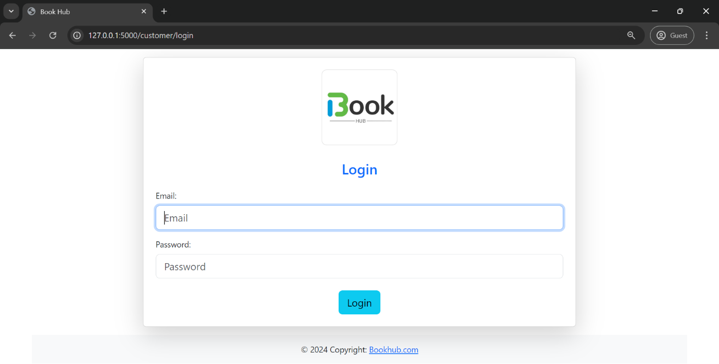
Project Development Cycle-Screenshots
Project Development Cycle

Slide 21
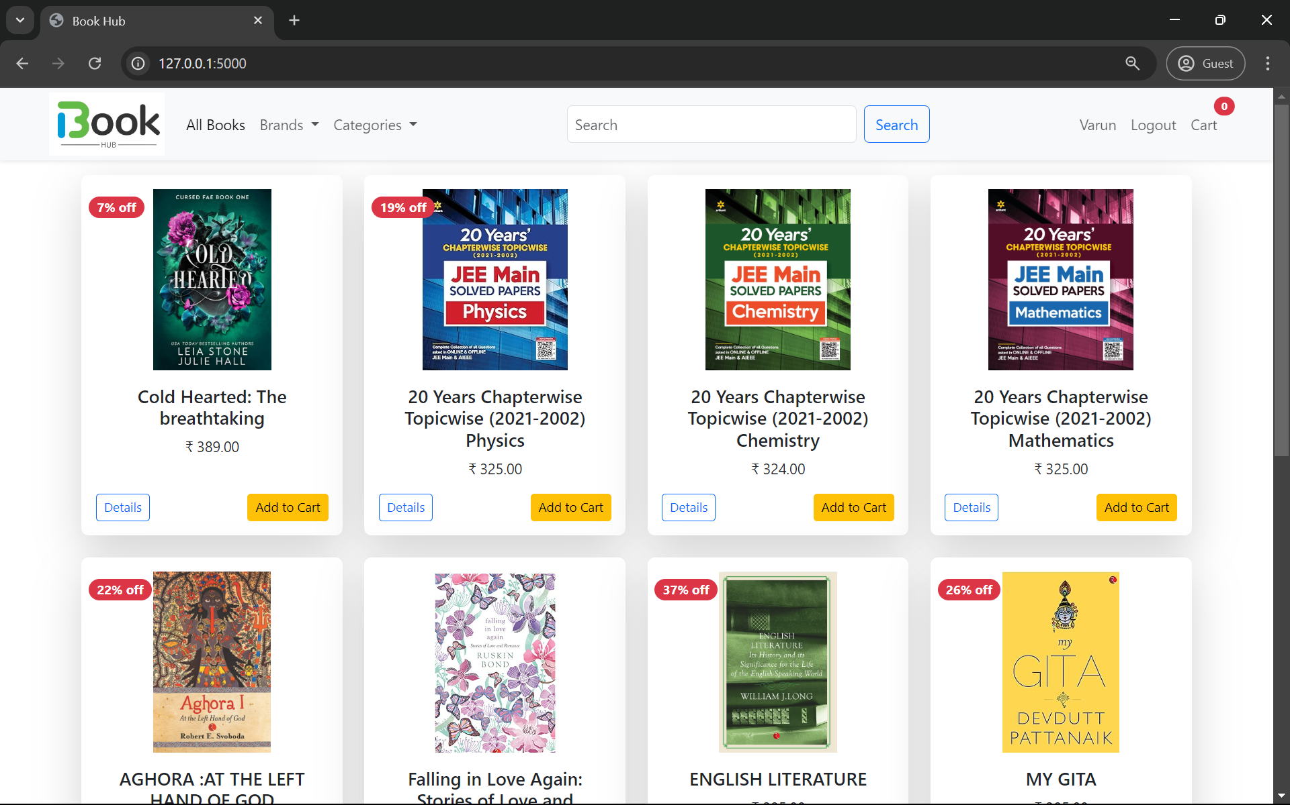
Home

Slide 22
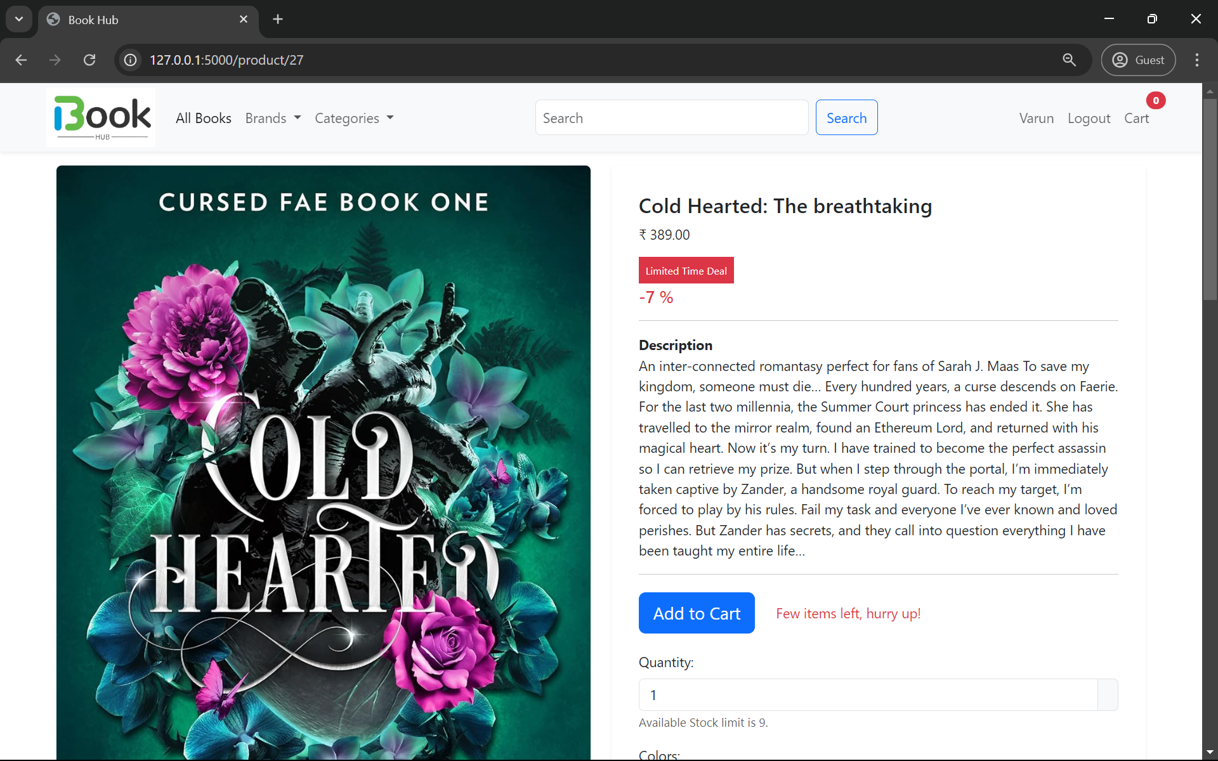
Single Book Page

Slide 23
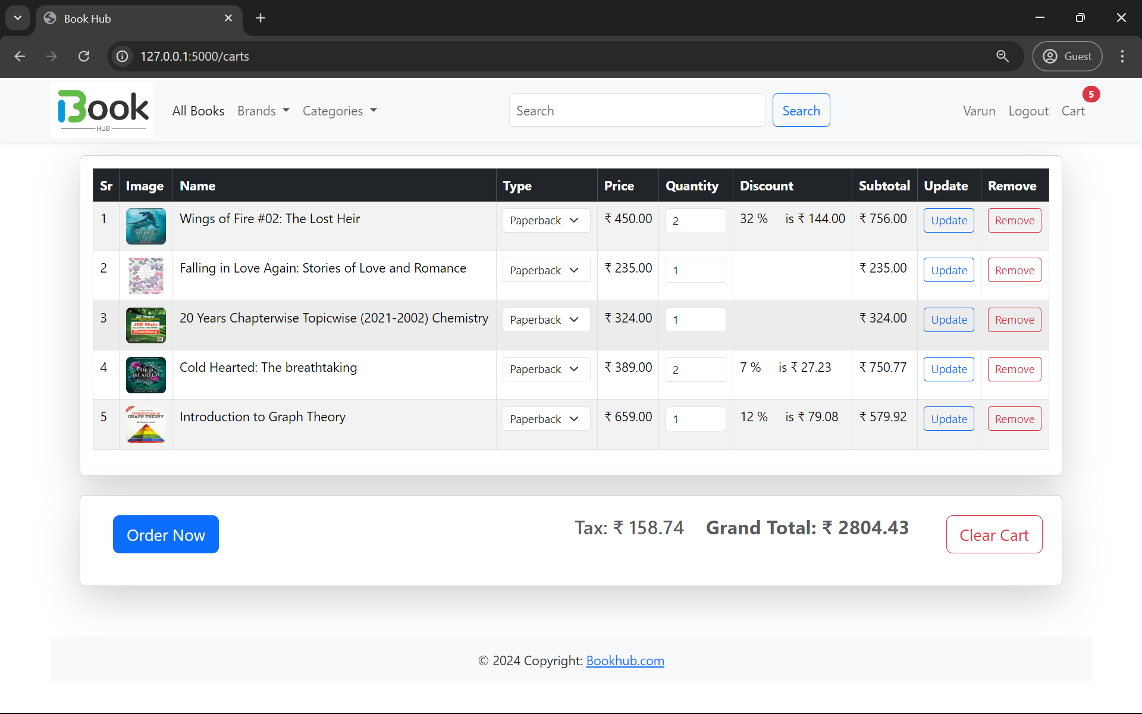
Cart Page

Slide 24
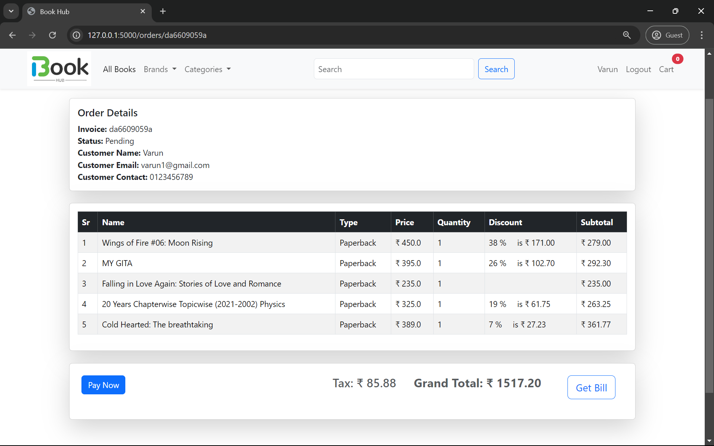
Checkout Page

Slide 25
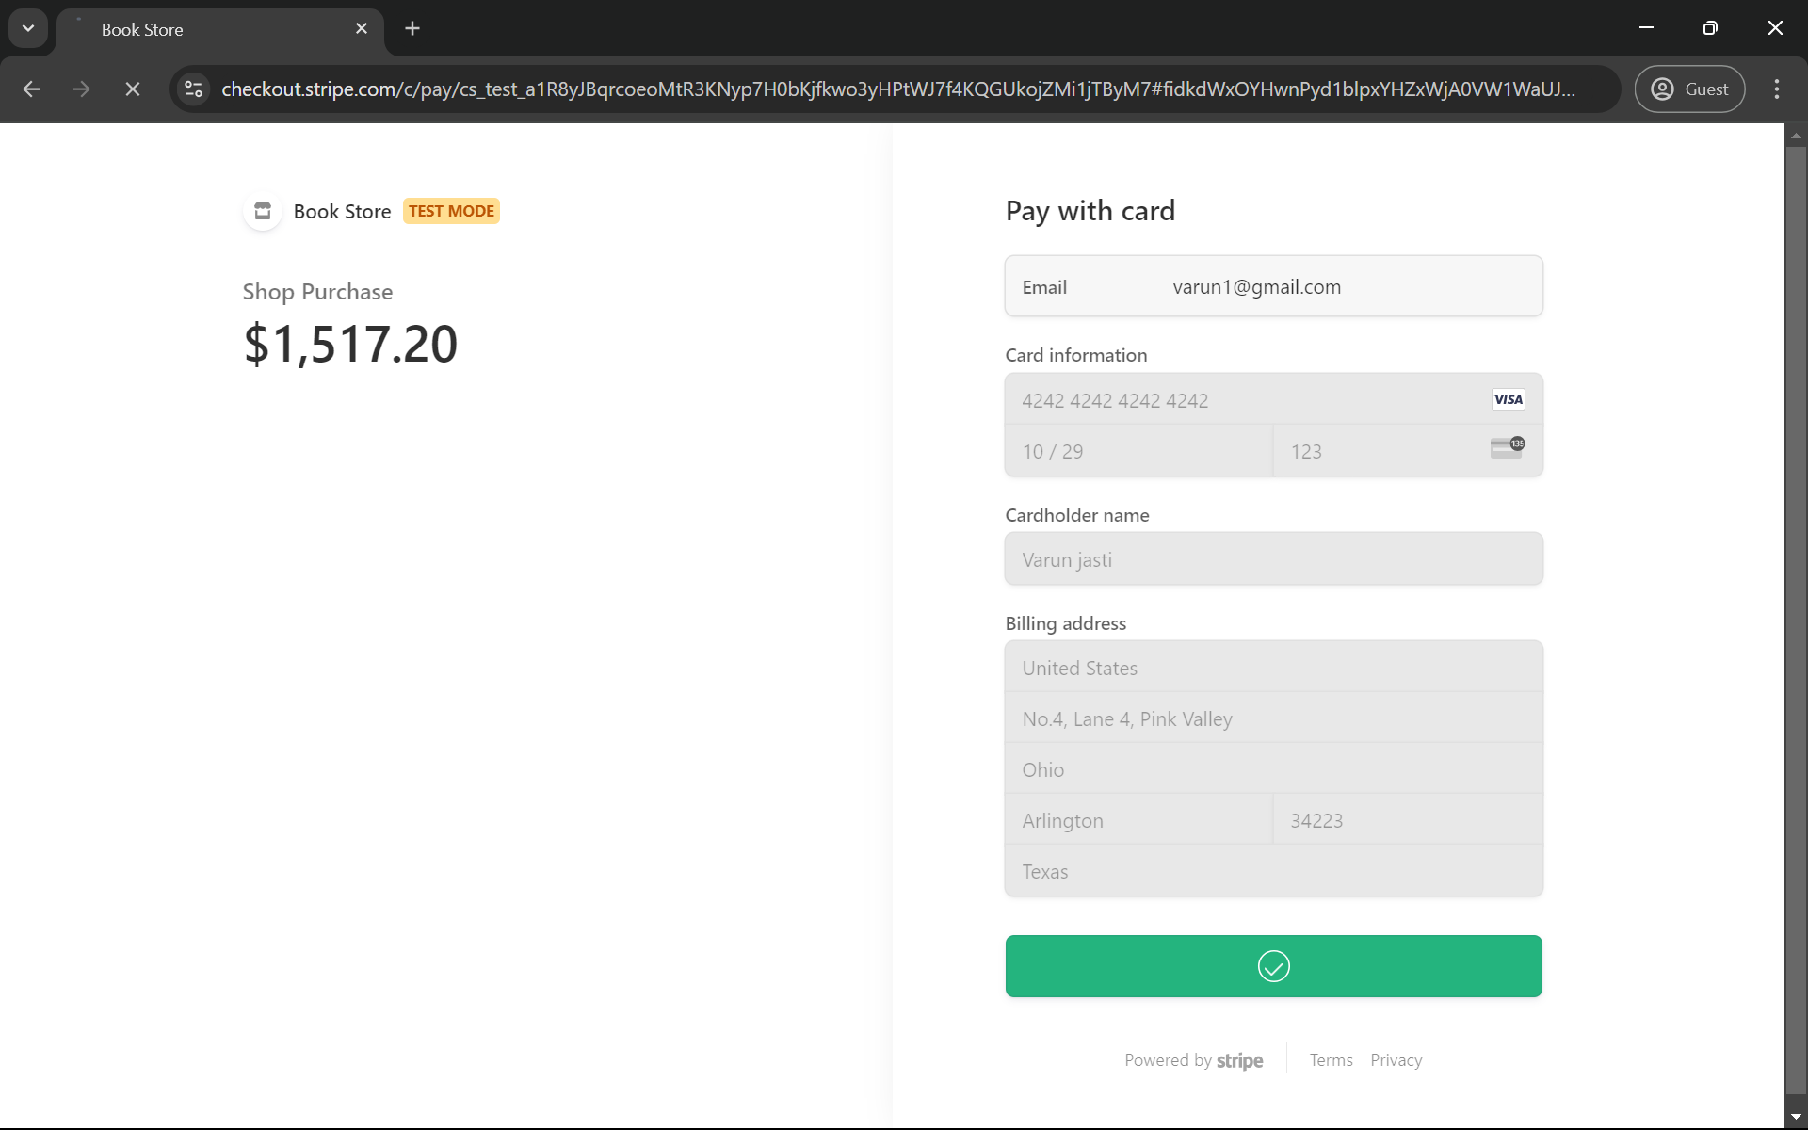
Payment Page

Slide 26
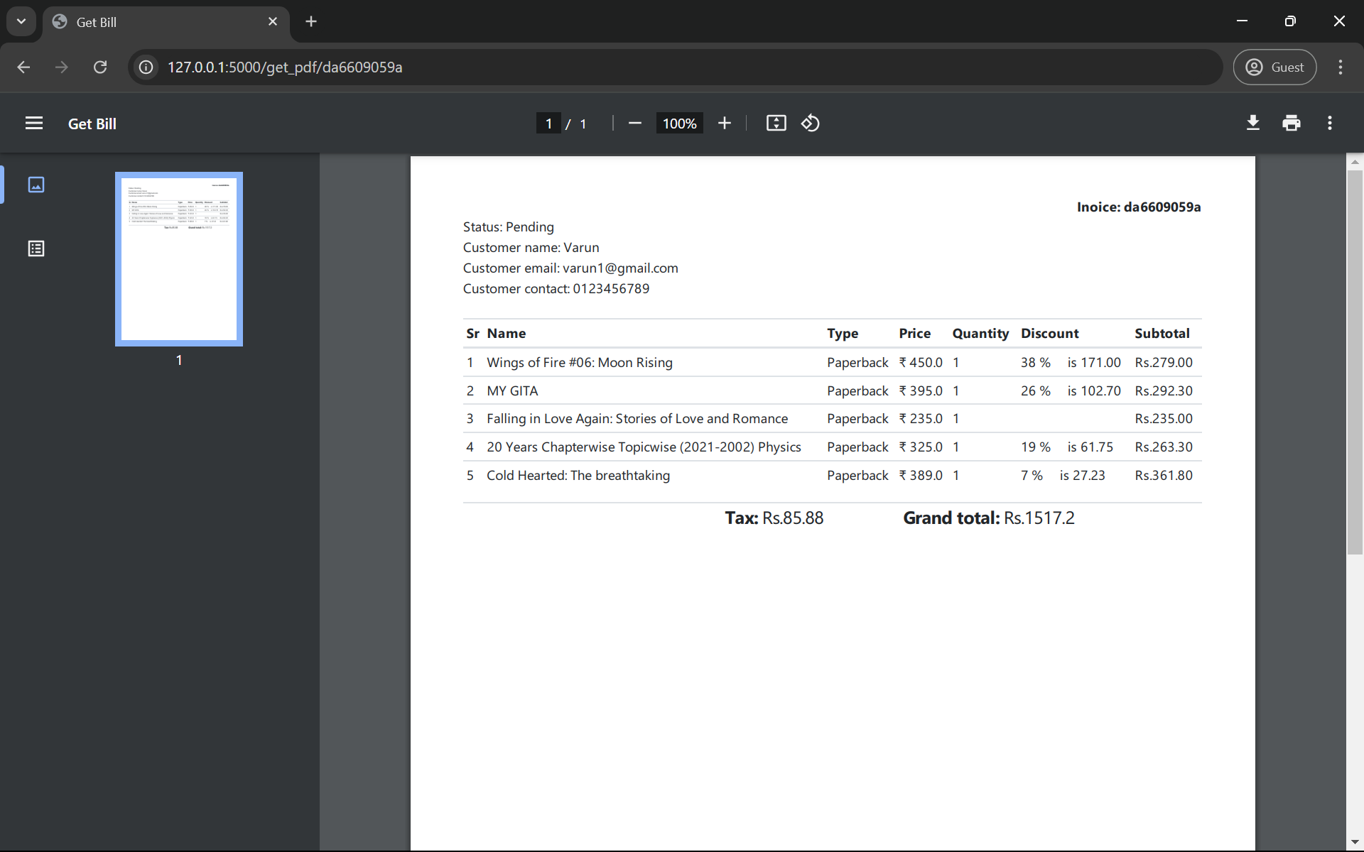
Invoice/Bill

Slide 27
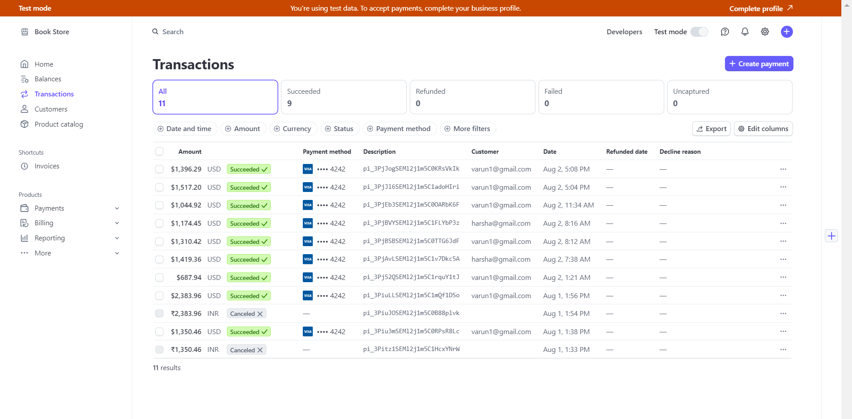
Admin account

Slide 28
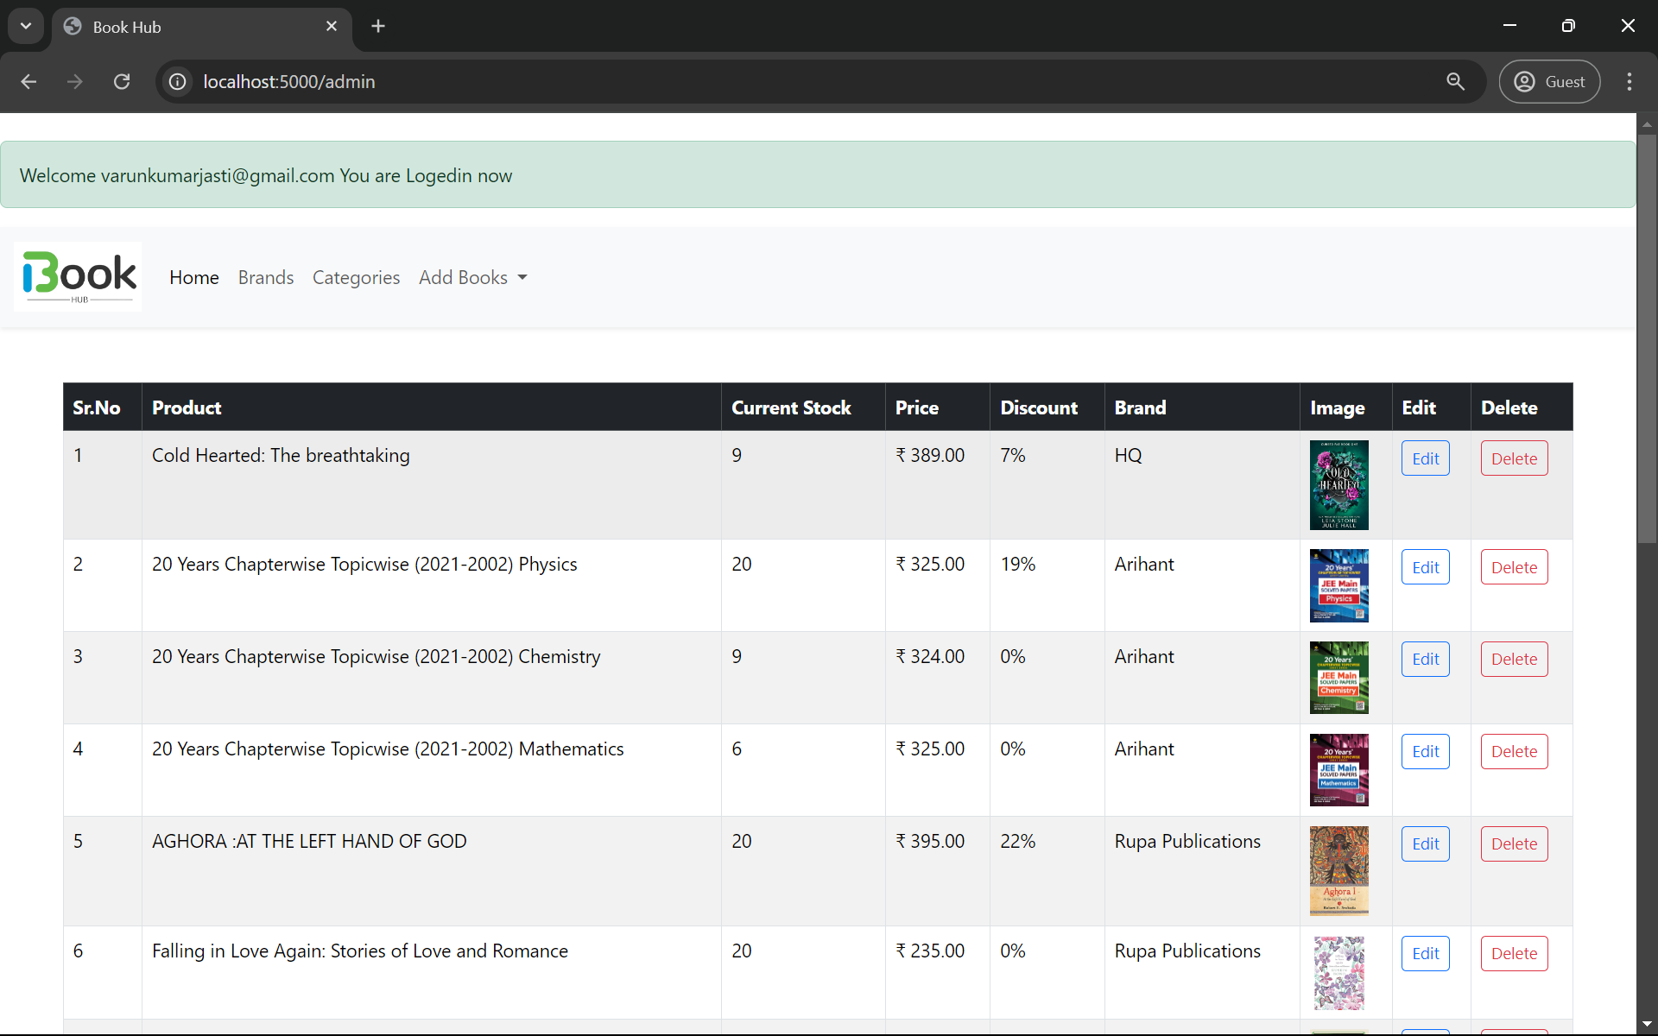
Admin Home

Slide 29
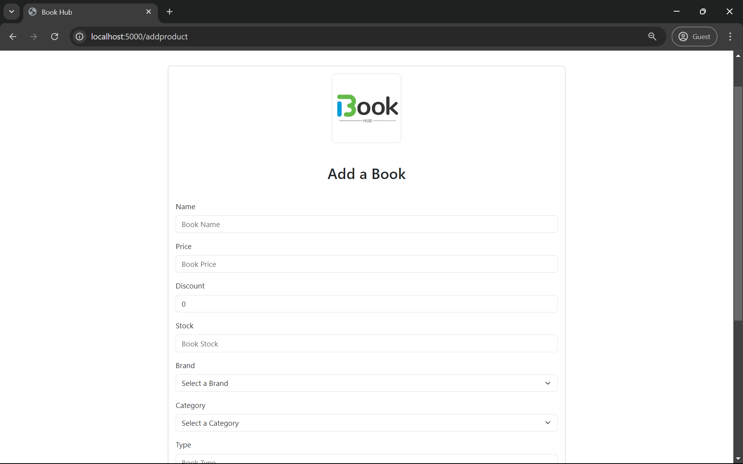
Add Book

Slide 30
Project Development Cycle-Success
User Satisfaction:
User Feedback: Collect and review feedback from surveys, ratings, and reviews to understand user opinions.
Net Promoter Score (NPS): Measure how likely users are to recommend your bookstore to others.
Financial Performance:
Cost Savings: Check if you’ve saved money due to better financial planning and analysis.
Return on Investment (ROI): Compare the financial gains from the bookstore to the costs of developing and running it.
Performance:
Response Time: Measure how quickly your website responds to user actions and requests.
Project Development Cycle

Slide 31
Project Development Cycle-Recommendations for future work
Integrate Payment Gateway: Add a secure and user-friendly payment gateway to make online transactions smooth and safe. This will be crucial in the next development phase to ensure customers can easily pay for their purchases.
Develop a Mobile Application: Create a mobile app for Android and iOS to let users shop and manage their accounts from their phones. This will improve user experience and attract more customers.
Project Development Cycle

Slide 32
Project Development Cycle-Recommendations for future work
Expand Personalization Features: Enhance features that tailor recommendations, marketing emails, and promotions to individual users. This will boost customer satisfaction and encourage repeat business.
Enhance Security Measures: Regularly update security practices to safeguard customer data and transactions. Use advanced encryption and conduct security audits to keep customer trust.
Customer Feedback Integration: Set up a system to gather ongoing feedback from customers. This will help identify areas for improvement and adjust the service to better meet their needs.
Project Development Cycle

Slide 33
Project Development Cycle-Conclusions and Summary
Developed a User-Friendly Website: Conclusion: The website was designed to be intuitive and responsive, making it easier for customers to navigate and have a better shopping experience.
Implemented an Efficient Inventory Management System: Conclusion: A robust inventory management system was integrated, which has streamlined order processing and minimized errors, enhancing overall efficiency.
Provided Personalized Recommendations: Conclusion: Algorithms for personalized recommendations were successfully developed, leading to increased customer satisfaction by offering relevant product suggestions.
Ensured Robust Security Measures: Conclusion: Strong security protocols were established to protect customer data and transactions, ensuring a safe and trustworthy shopping environment.
Project Development Cycle

Slide 34
Github
Click Here for Github repositry
Version Control:
We used GitHub to manage different versions of our code. This allowed us to keep track of changes and revert to previous versions if needed.
Collaboration:
GitHub made it easy for team members to collaborate. Everyone could work on different parts of the project simultaneously and merge their changes without conflicts
Code Review:
Team members could review each other’s code, provide feedback, and ensure the quality and consistency of the codebase.
Creation of Github Repository

Slide 35
Project Development Cycle-Lessons learnt
Impact on Society Beyond Science and Technology: The online bookstore makes it easier for people, including those in remote areas, to access books. It also supports learning and literacy by offering a wide selection of books online.
Interdisciplinary Work: The project brought together web development, database management, and security skills to build a complete online bookstore.
Learnings from Project Development: Learned how to plan effectively, work well with a team, adapt to changes, focus on important features, and test regularly to ensure everything works smoothly.
Project Reflection

Slide 36
References
For design of templates and UI/UX:
99 Books Store. https://www.99booksstore.com/. Accessed 10 June 2024.
Flipkart. Books Store. https://www.flipkart.com/books-store. Accessed 10 June 2024
Books wagon. https://www.bookswagon.com/. Accessed 10 June 2024.
99 Books Cart. https://www.99bookscart.com/. Accessed 10 June 2024.
For Development
"Flask E-commerce Website Tutorial." [YouTube]. Created by DevExpert. https://www.youtube.com/watch?v=eDTcSaZcLh4&t=427s. Accessed 15 June 2024.
"Online Bookstore Development Course." [YouTube Playlist]. Created by Jamal Bugti. https://www.youtube.com/playlist?list=PLYPlvTh05MsxJja9bzQCSTDu4hnEv5N_u. Accessed 20 June 2024.
"Stripe Integration in Flask Applications." [YouTube]. Created by WebDevMaster. https://www.youtube.com/watch?v=2Ax_P_SmBh4&t=873s. Accessed 12 July 2024
"Web Development with Python Tutorial." [YouTube]. Created by Freecodecamp. https://www.youtube.com/watch?v=yBDHkveJUf4. Accessed 10 June 2024.
References

Slide 37
We extend our deepest gratitude to our project mentor Neetesh Parasar sir, for his invaluable guidance and support throughout this project. His expertise and encouragement have been instrumental in shaping our work and ensuring its success. Our heartfelt thanks to Dr. Geetha Prakash mam and the ByteXL Team for providing us with this incredible opportunity to showcase our skills and knowledge. Their support and resources have been crucial to our project's development.
We would also like to acknowledge our team members for their dedication, hard work, and collaboration. Each member's contribution was vital to the project's success, and their teamwork and perseverance were exemplary.
Acknowledgement
Acknowlegements if any

